Slide 1

DOM Events
Handling DOM Events, Propagation & Delegation
SoftUni Team
Technical Trainers
Software University
https://softuni.bg

Slide 2
Table of Contents
Creating DOM Elements
Browser Events
Handling Events
Event Propagation
2
Notes:
2

Slide 3
Have a Question?
sli.do
#js-advanced
Notes:
3

Slide 4
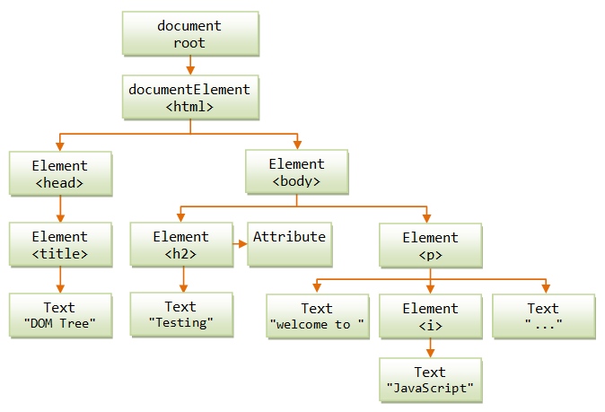
DOM Manipulation
Modify the DOM Tree

Slide 5

DOM Manipulations
We can create, append and remove HTML elements dynamically
appendChild()
removeChild()
replaceChild()

Slide 6
Creating New DOM Elements
HTML elements are created with document.createElement
This is called a Factory Pattern
Variables holding HTML elements are live:
If you modify the contents of the variable, the DOM is updated
If you insert it somewhere in the DOM, the original is moved
Text added to textContent will be escaped
Text added to innerHTML will be parsed and turned into actual HTML elements → beware of XSS attacks!

Slide 7
Creating DOM Elements
Creating a new DOM element
Create a copy / cloning DOM element
Elements are created in memory – they don't exist on the page
To become visible, they must be appended to the DOM tree
Tag name
let p = document.createElement("p");
let li = document.createElement("li");
let li = document.getElementById("my-list");
let newLi = li.cloneNode(true);

Slide 8
Manipulating Node Hierarchy
appendChild - Adds a new child, as the last child
prepend - Adds a new child, as the first child
let p = document.createElement("p");
let li = document.createElement("li");
li.appendChild(p);
let ul = document.getElementById("my-list");
let li = document.createElement("li");
ul.prepend(li);

Slide 9
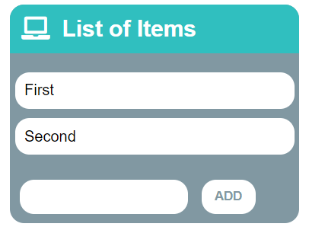
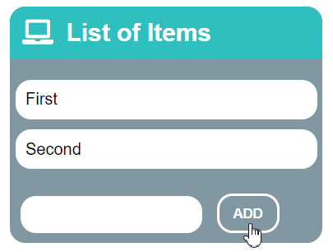
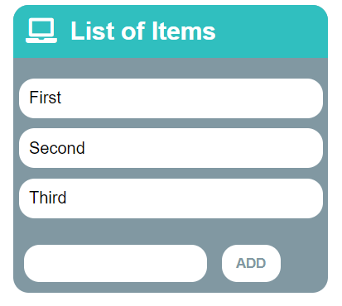
Problem: List of Items
Create a HTML page holding a list of items + text box + button for adding more items to the list
Write a function to append the specified text to the list
Check your solution here: https://judge.softuni.bg/Contests/Practice/Index/2762#0

Slide 10
Problem: List of Items – HTML
<h1>List of Items</h1>
<ul id="items"><li>First</li><li>Second</li></ul>
<input type="text" id="newItemText" />
<input type="button" value="Add" onclick="addItem()">
<script>
function addItem() {
// TODO: Add new item to the list
}
</script>

Slide 11
Solution: List of Items
function addItem() {
let text = document.getElementById('newItemText').value;
let li = document.createElement("li");
li.appendChild(document.createTextNode(text));
document.getElementById("items").appendChild(li);
//clearing the input:
document.getElementById('newItemText').value = '';
}

Slide 12
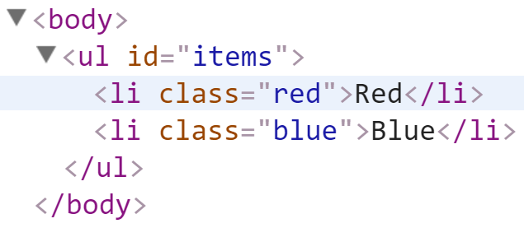
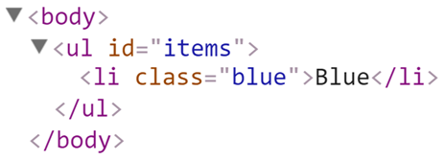
Deleting DOM Elements
<ul id="items">
<li class="red">Red</li>
<li class="blue">Blue</li>
</ul>
let redElements =
document.querySelectorAll("#items li.red");
redElements.forEach(li => {
li.parentNode.removeChild(li);
});

Slide 13
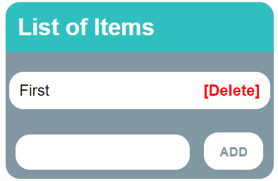
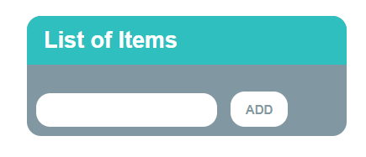
Problem: 2. Add / Delete Items
Extend the previous problem
Implement [Delete] action as link after each list item
Check your solution here: https://judge.softuni.bg/Contests/Practice/Index/2762#1

Slide 14
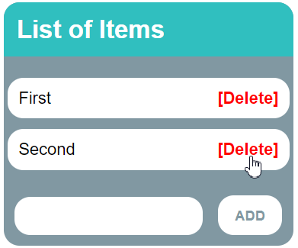
Problem: 2. Add / Delete Items – HTML
<h1>List of Items</h1>
<ul id="items"></ul>
<input type="text" id="newText" />
<input type="button" value="Add" onclick="solve()">
<script>
function solve() { // TODO...
}
</script>

Slide 15
Solution: 2. Add / Delete Items
function solve() {
let newElement = document.getElementById("newText").value;
let list = document.getElementById("items");
if (newElement.length === 0) return;
let listItem = document.createElement("li");
listItem.textContent = newElement;
let remove = document.createElement("a");
let linkText = document.createTextNode("[Delete]");
// Continued on the next slide ...

Slide 16
Solution: 2. Add / Delete Items
remove.appendChild(linkText);
remove.href = "#";
remove.addEventListener("click", deleteItem);
listItem.appendChild(remove);
list.appendChild(listItem);
function deleteItem() {
listItem.remove();
}
}

Slide 17
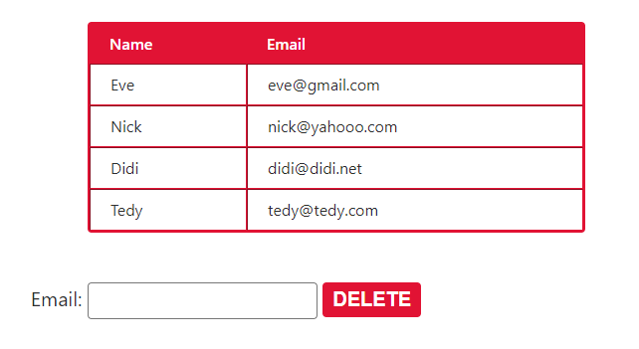
Problem: Delete from Table
<table border="1" id="customers">
<tr><th>Name</th><th>Email</th></tr>
<tr><td>Eve</td><td>eve@gmail.com</td></tr>
<tr><td>Nick</td><td>nick@yahooo.com</td></tr>
<tr><td>Didi</td><td>didi@didi.net</td></tr>
<tr><td>Tedy</td><td>tedy@tedy.com</td></tr>
</table>
Email: <input type="text" name="email" />
<button onclick="deleteByEmail()">Delete</button>
<div id="result" />
Check your solution here: https://judge.softuni.bg/Contests/Practice/Index/2762#2

Slide 18
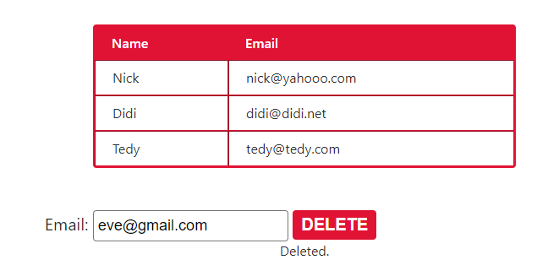
Solution: Delete from Table
function deleteByEmail() {
let email = document.getElementsByName("email")[0].value;
let secondColumn = document.querySelectorAll(
"#customers tr td:nth-child(2)");
for (let td of secondColumn)
if (td.textContent == email) {
let row = td.parentNode;
row.parentNode.removeChild(row);
document.getElementById('result').
textContent = "Deleted.";
return;
}
document.getElementById('result').textContent = "Not found.";
}

Slide 19

The DOM Event
Event Object and Types

Slide 20
Event Object
Calls its associated function
Passes a single argument to the function - a reference to the event object
Contains properties that describe the event
Which element triggered the event
Screen coordinates where it occurred
What is the type of the event
And more

Slide 21
Event Types in DOM API
Mouse events
Touch events
DOM / UI events
click
mouseover mouseout mousedown
mouseup
touchstart
touchend
touchmove
touchcancel
load
unload
resize
dragstart / drop
Keyboard events
Focus events
Form events
keydown
Keypress
keyup
input
change
submit
reset
focus (got focus)
blur (lost focus)

Slide 22

Event Handling

Slide 23
Event Handler
Event registration is done by providing a callback function
Three ways to register for an event:
With HTML Attributes
Using DOM element properties
Using DOM event handler – preferred method
function handler(event){ // this --> object, html reference
// event --> object, event configuration }

Slide 24

Event Listener
addEventListener();
removeEventListener();
htmlRef.addEventListener( 'click' , handler , false );
htmlRef.removeEventListener( 'click' , handler);

Slide 25
Attaching Click Handler
const button = document.getElementsByTagName('button')[0];
button.addEventListener('click', clickMe);
function clickMe(e) {
const target = e.currentTarget;
const targetText = target.textContent;
target.textContent = Number(targetText) + 1;
}

Slide 26
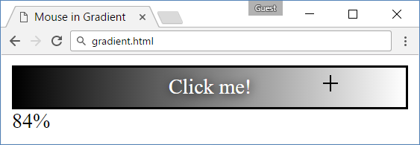
Problem: Mouse in Gradient
A HTML page holds linear gradient box
Moving the mouse should show percentage [0% … 100%], depending on the location of mouse
Left side → 0%; middle → 50%; right side → 100%
Check your solution here: https://judge.softuni.bg/Contests/Practice/Index/2762#3

Slide 27
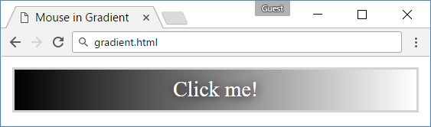
Problem: Mouse in Gradient – HTML
<html>
<head>
<title>Mouse in Gradient</title>
<link rel="stylesheet" href="gradient.css" />
<script src="gradient.js"></script>
</head>
<body onload="attachGradientEvents()">
<div id="gradient-box">
<div id="gradient">Click me!</div>
</div>
<div id="result"></div>
</body>
</html>

Slide 28
Problem: Mouse in Gradient – CSS
#gradient-box {
width: 300px;
border: 2px solid lightgrey;
}
#gradient-box:hover {
border: 2px solid black;
}
#gradient {
height: 30px;
color: white;
text-shadow:
1px 1px 10px black;
text-align: center;
line-height: 30px;
background:
linear-gradient(
to right, black, white);
cursor: crosshair;
}

Slide 29
Solution: Mouse in Gradient
function attachGradientEvents() {
let gradient = document.getElementById('gradient');
gradient.addEventListener('mousemove', gradientMove);
gradient.addEventListener('mouseout', gradientOut);
function gradientMove(event) {
let power = event.offsetX / (event.target.clientWidth - 1);
power = Math.trunc(power * 100);
document.getElementById('result').textContent = power + "%";
}
function gradientOut(event) {
document.getElementById('result').textContent = "";
}
};

Slide 30

Live Demonstration
Lab Problems 5 and 6

Slide 31
Events Handler Execution Context
In event handlers, this refers to the event source element
Pay attention when using object methods as event listeners!
this may not behave as you expect with objects
element.addEventListener("click", function(e) {
console.log(this === e.currentTarget); // Always true
});

Slide 32
Attaching Hover Handler
const button = document.getElementsByTagName('div')[0];
button.addEventListener('mouseover', function (e) {
const style = e.currentTarget;
const { backgroundColor } = style;
if(backgroundColor === 'white'){
targetStyles.backgroundColor = '#234465';
targetStyles.color = 'white';
} else {
targetStyles.backgroundColor = 'white';
targetStyles.color = '#234465';
}}
);

Slide 33
Attaching Input Handler
const inputField = document.getElementsByTagName('input')[0];
const button = document.getElementsByTagName('button')[0];
inputField.addEventListener('input', function () {
button.setAttribute('disabled', 'false')
});

Slide 34
Remove Listeners
const password = document.querySelector('input[type="password"]');
const button = document.querySelector('button');
password.addEventListener('focus', focusEvent);
function focusEvent (){
event.target.style.background = '#234465';
}
password.addEventListener('blur', (event) => {
event.target.style.background = '';
});
button.addEventListener('click', () => {
password.removeEventListener('focus', focusEvent);
});

Slide 35
Multiple Listeners
The addEventListener() method also allows you to add many listeners to the same element, without overwriting existing ones:
Note that you don't use the "on" prefix for the event use "click" instead of "onclick"
element.addEventListener("click", myFirstFunction);
element.addEventListener("click", mySecondFunction);
element.addEventListener("mouseover", myThirdFunction);
element.addEventListener("mouseout", myFourthFunction);

Slide 36

Event Propagation
Handling Events Away From Their Source

Slide 37
Event Propagation
Window
CAPTURE
BUBBLING
Document
<HTML>
<BODY>
<HEADER>
<DIV>
<DIV>
<A>
<A>
TARGET

Slide 38
DOM Event Delegation
Allows you to avoid adding event listeners to specific nodes
Event listener is assigned to a single ancestor
<ul id="parent-list">
<li id="post-1">Item 1</li>
<li id="post-2">Item 2</li>
</ul>
document.getElementById("parent-list")
.addEventListener("click", function(e) {
if(e.target && e.target.nodeName == "LI") {
console.log(
"List item ", e.target.id.replace("post-", ""),
" was clicked!");
}
});

Slide 39
Pros and Cons
Benefits
Simplifies initialization
Saves memory
Less code
Limitations
Event must be bubbling
May add CPU load

Slide 40
Live Demonstration
Lab Problem 7

Slide 41
Controlling Propagation and Behavior
stopPropagation prevents further propagation of the event
If there are multiple handlers for the same event
preventDefault stop the browser from executing default behavior, for example:
Navigating to a new page when <a> is clicked
Submitting HTTP requests via forms
Opening context menus

Slide 42
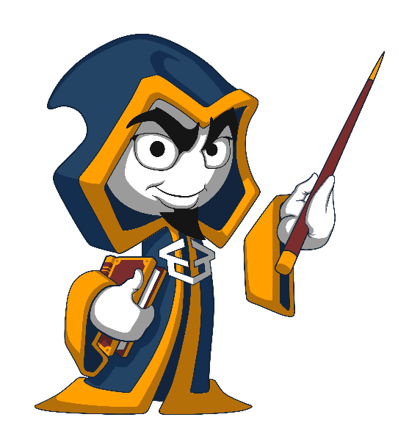
Summary
The DOM tree can be manipulated by:
Creating and deleting elements
Moving elements between nodes
User interaction triggers events
They can be listened to and handled
The handler receives event details
Events propagate through the DOM tree
…
…
…

Slide 43
Questions?
Notes:
43

Slide 44











SoftUni Diamond Partners

Slide 45



Educational Partners

Slide 46

License
This course (slides, examples, demos, exercises, homework, documents, videos and other assets) is copyrighted content
Unauthorized copy, reproduction or use is illegal
© SoftUni – https://about.softuni.bg/
© Software University – https://softuni.bg
Notes:
46

Slide 47
Trainings @ Software University (SoftUni)
Software University – High-Quality Education, Profession and Job for Software Developers
softuni.bg, about.softuni.bg
Software University Foundation
softuni.foundation
Software University @ Facebook
facebook.com/SoftwareUniversity
Software University Forums
forum.softuni.bg
Notes:
47

